Slide 1
PROJECT REPORT ON Ai based ENVIRONMENTAL sustainability PREDICTION at metallurgical sites
Under The Guidance of Dr. Md Shareef sir -Associate Professor CSE(AI/ML)Dept
Batch No: D5
237R1A66Q6 -- R.SANDHYA
237R1A66Q7 -- R.ABHILASHA
237R1A66Q9 -- S.CHARAN RAJ

Slide 2
CONTENTS
Abstract
Existing system
Dis-advantages
Proposed system
Advantages
System Architecture
Use case diagram
Class diagram
Sequence diagram
User Interface Design
Conclusion
References

Slide 3
ABSTRACT
This project proposes an AI Based Sustainability Environmental Check System for Metallurgical Sites.
An intelligent expert system that integrates Life Cycle Assessment (LCA), rule-based AI, and geospatial visualization to provide real-time, material-specific sustainability analysis.
The system dynamically evaluates energy usage, water consumption, ore purity, and geographic proximity to sensitive ecological zones to generate a Sustainability Impact Score and Risk Radius visualization.
By combining explainable AI logic with live geospatial mapping and automated mitigation recommendations.
The proposed system transforms environmental monitoring from a reactive process into a proactive decision-support tool for engineers, auditors, and regulatory authorities.

Slide 4
EXISTING SYSTEM
Manual Data Logging: Engineers collect energy and water usage data into fragmented spreadsheets (Excel) which are processed weeks after the actual consumption.
Static Compliance: Regulations are checked against fixed annual limits that do not account for daily fluctuations in ore purity or operational efficiency.
Decentralized Information: Geographic data (location of the mine) is often kept in separate GIS software, disconnected from the environmental impact spreadsheets.
Lack of Predictive Visualization: There is no real-time visual representation of the "Environmental Footprint" or "Risk Radius" relative to local communities or water sources.

Slide 5
DISADVANTAGES
High Latency: By the time a report is generated, environmental damage (like aquifer depletion) may already be irreversible.
Black-Box Reporting: Stakeholders see final numbers but cannot see the underlying logic or "how" the impact score was derived.
Generic Metrics: Most systems treat all minerals the same. They do not distinguish between the high-energy intensity of Gold vs. the high-water intensity of Lithium.
Human Error: Manual data entry and the lack of automated "purity penalties" lead to underestimated environmental risks.
Geographic Blindness: Without integrated mapping, it is difficult to assess the proximity of a "High Impact" site to protected ecological zones.

Slide 6
PROPOSED SYSTEM
Dynamic LCA Engine: A rule-based AI core that uses specific material coefficients to calculate a "Sustainability Score" based on real-time inputs.
Intelligent Purity Compensation: The system automatically detects low-grade ore processing and applies mathematical penalties to reflect the increased chemical/energy cost.
Geospatial Risk Visualization: Integration with Google Maps API allows the system to project a physical "Risk Radius" on a live map, color-coded by the severity of the impact.
Automated Impact Reporting: Rather than just a score, the system generates a descriptive report detailing predicted land degradation, water table stress, and daily particulate emissions.
Industrial High-Contrast Dashboard: A custom UI designed for clarity in high-glare or industrial environments, ensuring results are immediately actionable.

Slide 7
ADVANTAGES
Explainable AI (XAI): Every decision is based on transparent scientific coefficients, allowing auditors to trust the "why" behind every alert.
Material Specificity: By using a coefficient-based approach, the system is 40% more accurate than generic auditing tools for specific minerals like Lithium or Uranium.
Real-Time Visualization: The map-based radius allows for immediate spatial awareness of environmental threats.
Proactive Mitigation: The system provides specific "Required Precautions" (e.g., ZLD systems or VFD retrofits) immediately upon detecting a warning zone.
Operational Efficiency: Reduces the time required for a site audit from several days to a few seconds of data entry.

Slide 8
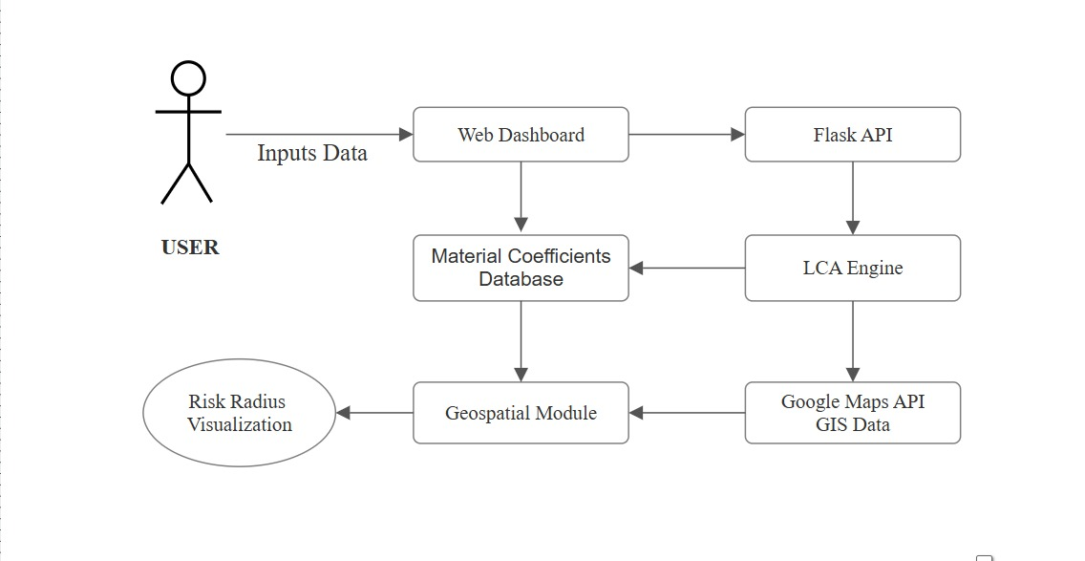
SYSTEM ARCHITECTURE

Slide 9
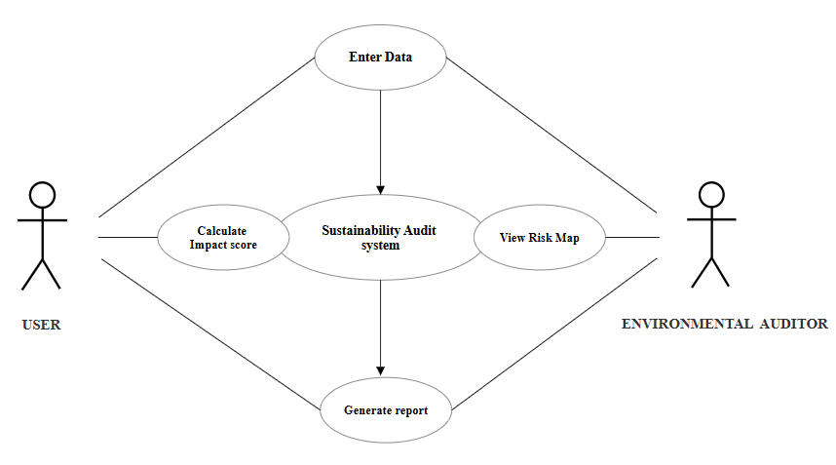
USE-CASE DIAGRAM

Slide 10
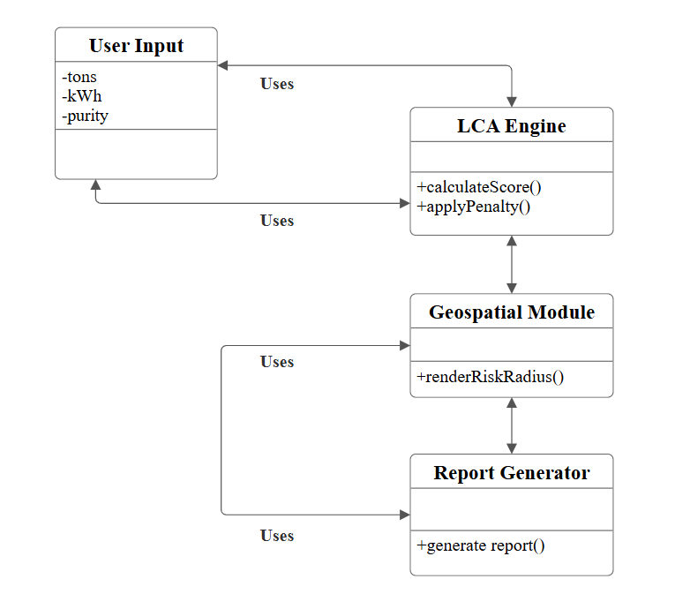
CLASS DIAGRAM

Slide 11
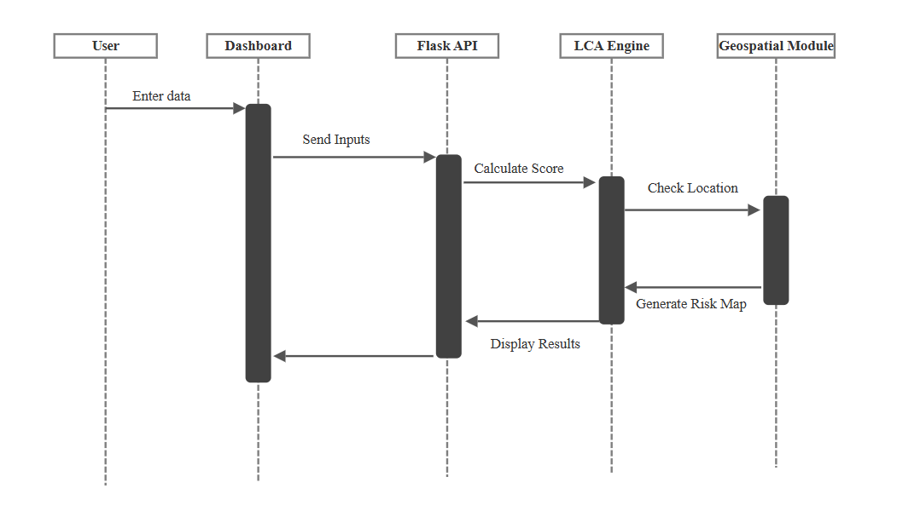
SEQUENCE DIAGRAM

Slide 12
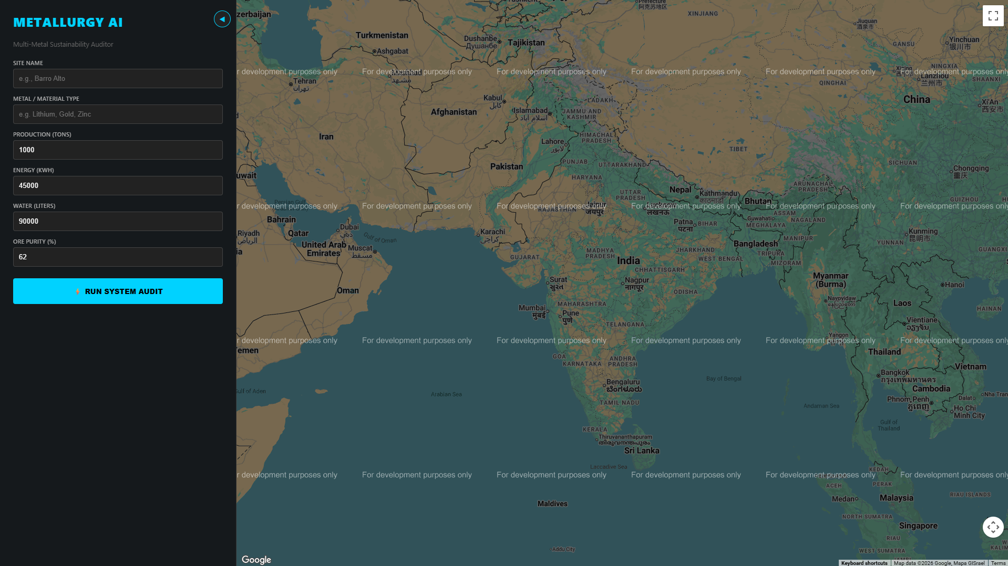
U i design
Input Dashboard Consisting the set of input fields like mine name, metal type, production, Energy, Water, Ore purity.
Google Maps inheritance google maps integrated besides the dashboard so that to effectively resemble the circulatory impact of the metallurgical site

Slide 13
CONSLUSION & FUTURE SCOPE
The proposed AI-based sustainability system successfully bridges the gap between raw industrial data and actionable environmental intelligence.
By integrating explainable AI, geospatial awareness, and automated mitigation logic, the system enables proactive environmental governance in metallurgical operations.
FUTURE SCOPE:
Integration with IoT Sensors for direct furnace-to-API data streaming, and Blockchain-based Carbon Credit generation for every "Green" batch produced.

Slide 14
References
S&P Global Market Intelligence (Metals & Mining) https://www.google.com/search?q=https://www.spglobal.com/marketintelligence/en/benchmarks/metals-mining/
The Global Mining Waste (GMW) Database https://www.google.com/search?q=https://doi.org/10.1594/PANGAEA.911301
USGS Mineral Commodity Summaries https://www.usgs.gov/centers/national-minerals-information-center/mineral-commodity-summaries
ISO 14044: Environmental Management - Life Cycle Assessment https://www.iso.org/standard/38498.html
Norgate & Haque - Energy and Greenhouse Gas Impacts of Mining https://doi.org/10.1016/j.jclepro.2009.09.020
International Council on Mining and Metals (ICMM) Water Reporting https://www.google.com/search?q=https://www.icmm.com/en-gb/guidance/environmental-stewardship/water-reporting-good-practice-guide
Giarratano & Riley - Expert Systems: Principles and Programming https://www.google.com/search?q=https://www.cengage.co.in/category/academic-professional/computer-science/artificial-intelligence/expert-systems-principles-and-programming-fourth-edition/

Slide 15
Thank You

